Slide 1

Sarah Green
Product Management & Design Intern
Summer 2015
Notes:
10 seconds

Slide 2

My Internship
Responsible for a new feature for Lithium-powered communities
Wore multiple hats
Product management
UI/UX design
Documentation
Preparing the feature for development and launch
Notes:
30 seconds

Slide 3


User Profile Cards
Notes:
10 seconds

Slide 4

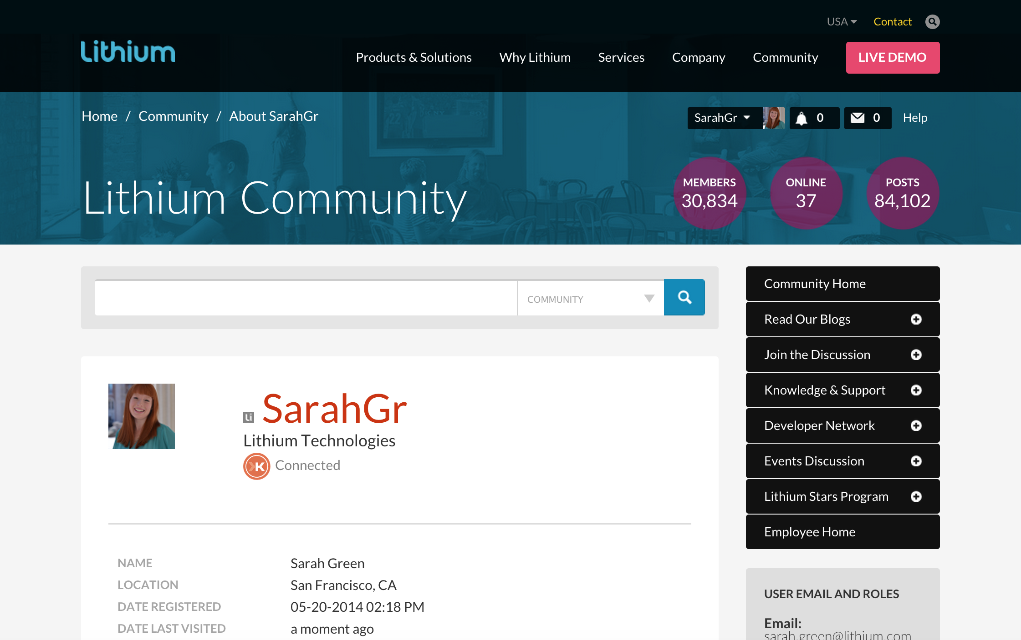
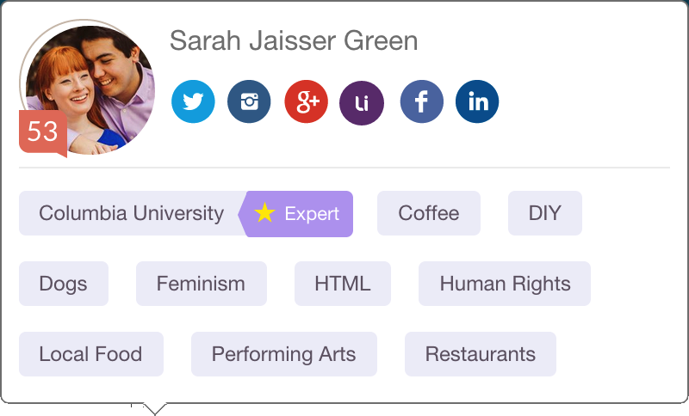
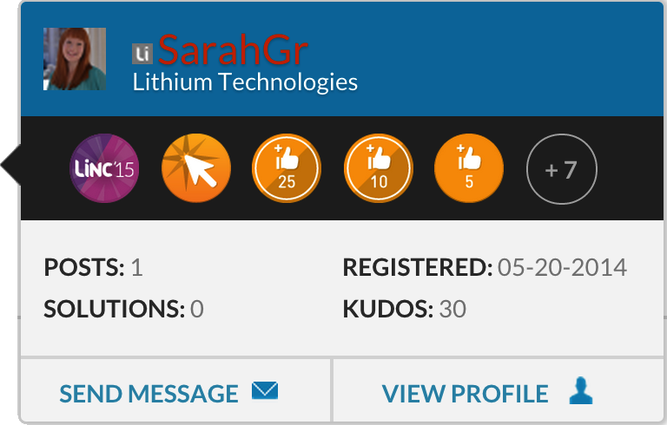
Starting Point
Notes:
30 seconds

Slide 5
My Process
Research
Propose a Solution
Design Phase A
Usability Testing
Modify the Solution
Design Phase B
Deliver the Solution
Notes:
30 seconds

Slide 6
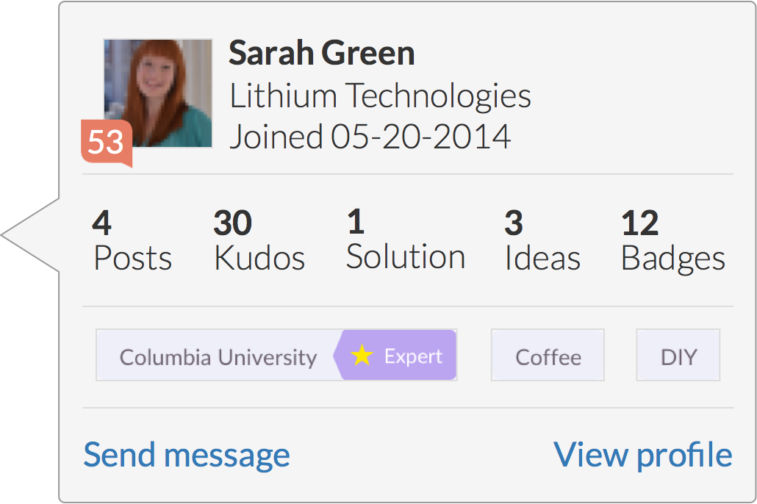
Desktop: Hovercard
Notes:
20 seconds

Slide 7
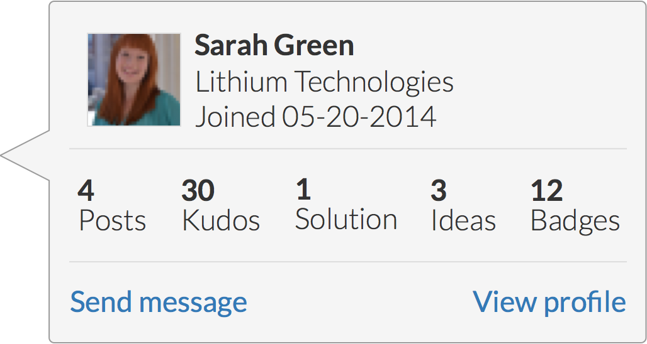
Updated Hovercard Design
Notes:
30 seconds

Slide 8
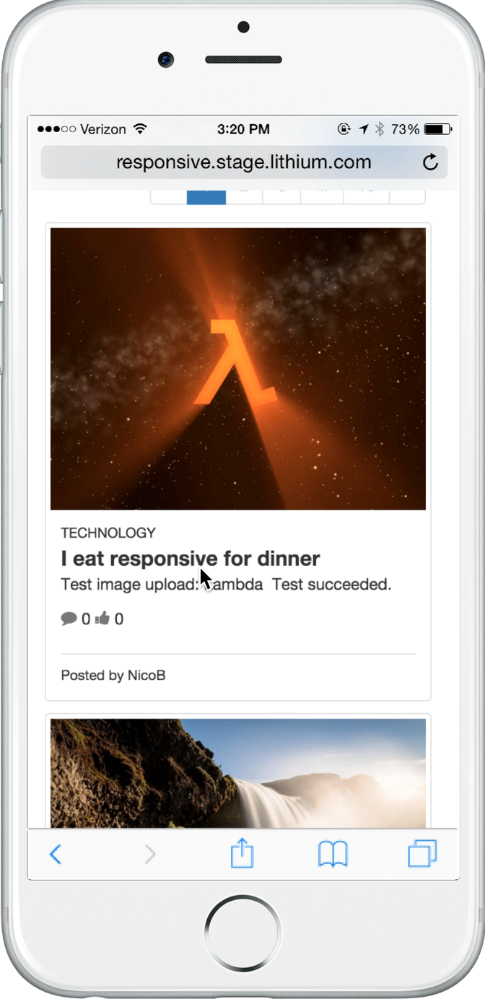
Responsive: Inline Accordion
Notes:
30 seconds

Slide 9
Who Cares?
The majority of our competitors offer a hovercard
… but most of them are carelessly designed
… and no one’s got a great responsive solution
End users are increasingly expecting helpful features like this one to quickly get a sense of their peers in context
We can please existing customers and community managers with relatively little overhead
It’s an opportunity to showcase how Klout data can improve the Lithium community experience
Notes:
45 seconds

Slide 10
What I’ve Learned
Being personally invested in customer success means not only adhering to best practices, but also being a leader in innovation
Building products we’re proud of requires knowing when to collaborate, when to seek help, and when to be independent
No matter your specific role on a software dev team, it’s vital to have a holistic understanding & appreciation of the others
Working in Product requires adapting rapidly, carefully, and gracefully to unforeseen changes to the roadmap or the project itself
It takes a village… Thanks Benji, James S, Karin, Suzie, John D, Tiffany, Lynne, Tim, Jeff C, Kirk, Leah, and everyone else who supported me!
Notes:
45 seconds

Slide 11

Thank you!
Any questions?

